Slide 1


OHID, MFA, & ID Proofing/DocV Enhancements
Supplemental Guide
Adoption Grant
February 2025

Slide 2
Table of Contents
Please note that this Job Aid is navigable. To jump between topics, please select an item from the list below.
1. OHID Account Creation………………………………………………………………3-7
2. OHID Username Recovery………………………………………..…………….…8-10
3. OHID Password Recovery……………………………………….……………….11-13
4. OHID FAQs……………………………………………………………………………...14-18
4. OHID Allow List Training……………………………….………..……………..…19-24
5. Multifactor Authentication (MFA) Process and Methods……….…25-52
6. MFA FAQs………………………………………………………………………………...53-57
7. Identity Proofing Process…………………………………………….…………...58-60
8. Document Verification Process………………………………………………..61-68
9. ID Proofing/ DocV FAQs…………………………………………………………..69-75
10. Troubleshooting/Incident Management Reminders………………..……76
11. Points of Contact…………………………………………………………………………...77

Slide 3
CREATING AN OHID
Please note: OHIDs are required by person. Each individual user should create their own OHID and register for MFA

Slide 4
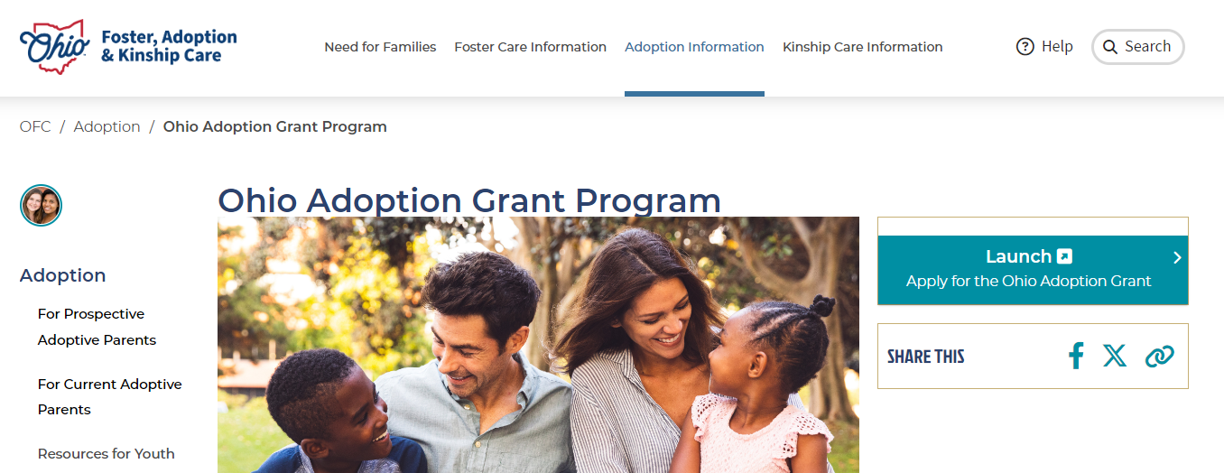
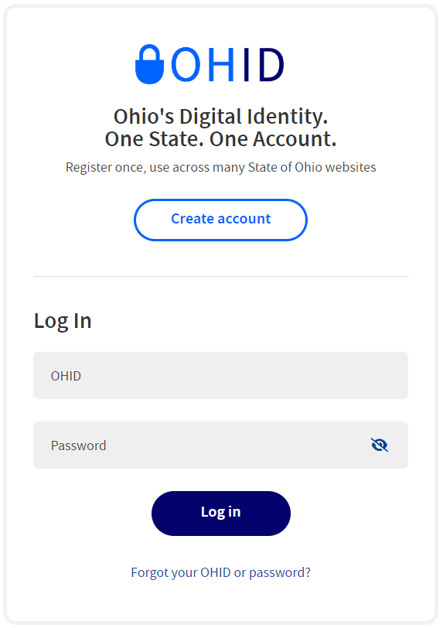
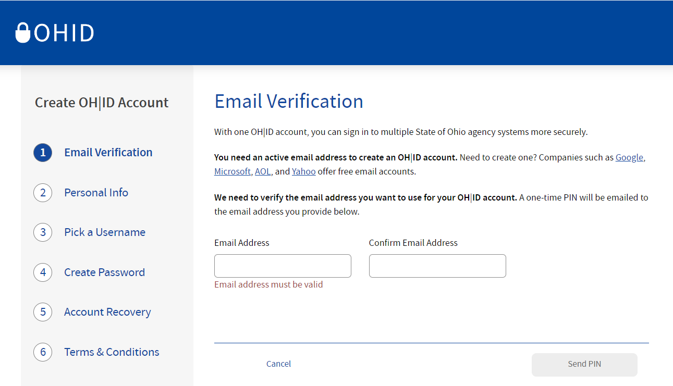
OHID Account Creation
1. User will navigate to the Adoption Grant website at the following URL: https://fosterandadopt.jfs.ohio.gov/adoption/grant. They will click “Launch” to be redirected to the OHID login page.
1
2
2. User will click “Create Account” to begin the OHID account creation process.
3
3. The user will enter an active email address to continue creating their account.

Slide 5
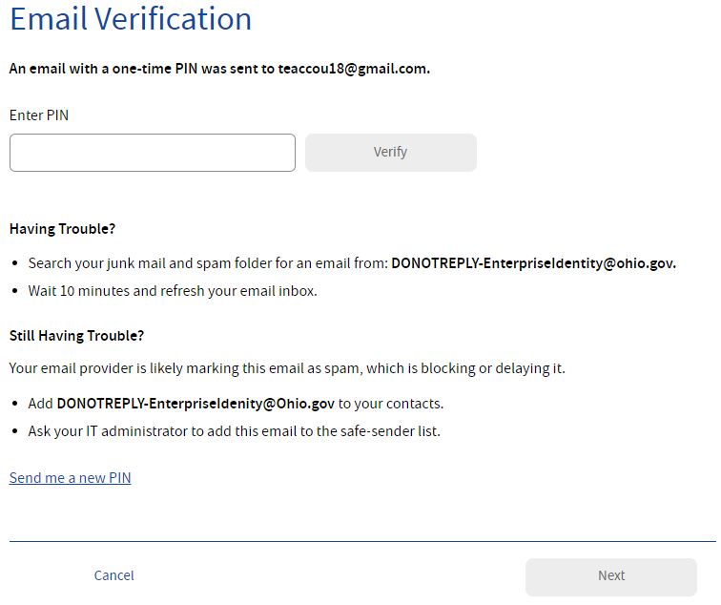
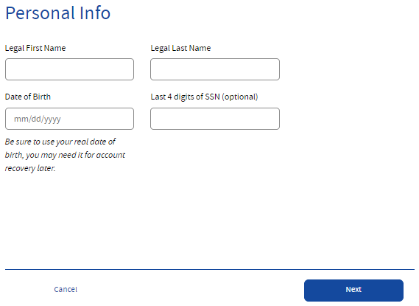
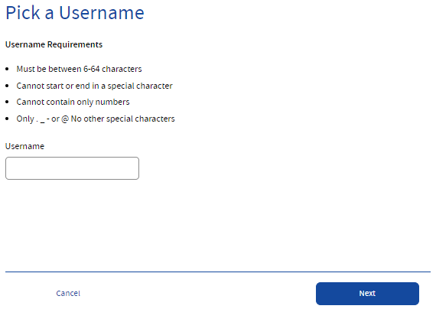
OHID Account Creation
4. After entering an email address, a PIN will be sent to that email address.
The user will enter the PIN provided on the email verification screen and select “Verify.”
Note: If they do not receive the PIN immediately, they can request a new PIN using the “Send a new PIN” link.
4
5. The user will enter their Legal First Name, Last Name, and Date of Birth in MM/DD/YYYY format to continue.
Note: Last 4 of SSN is an optional field.
5
6. User will create a username for their OHID account.
The username must be between 6-64 characters, cannot start or end with a special character, cannot contain only numbers, and may only contain . _ - or @ as special characters.
6

Slide 6
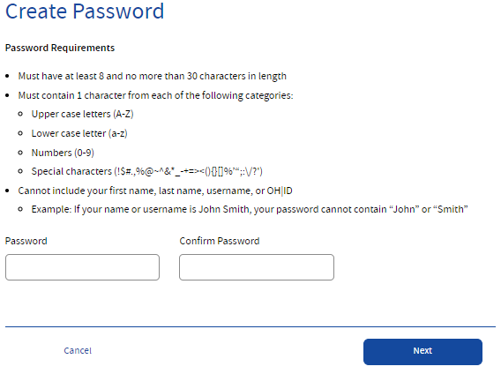
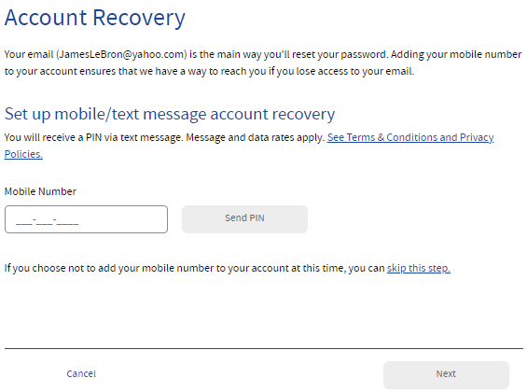
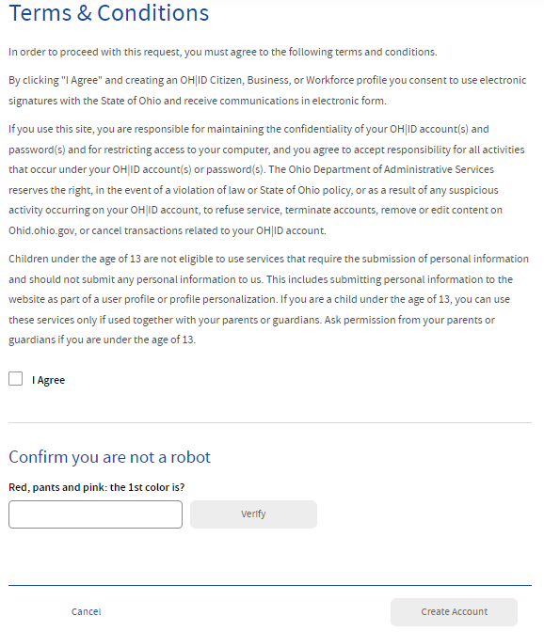
OHID Account Creation
7. The user will create and confirm a password for their OHID account.
Passwords must be between 12-30 characters; must contain at least one upper case letter, lower case letter, number, and special character; and cannot contain the user’s first name, last name, username, or OHID. The new password will expire in 400 days.
7
8. The user will enter an active mobile phone number to enable account recovery.
They will click “Send PIN” to send a PIN to the mobile phone number.
The user will enter that PIN to verify their mobile phone.
8
9
9. The user will check the “I Agree” box under the Terms & Conditions section and answer the “Confirm you are not a robot” question.
Next, the user will click “Verify,” and then “Create Account.”

Slide 7
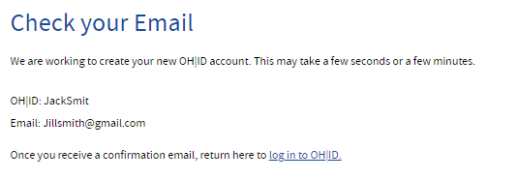
OHID Account Creation
10. The user will verify receipt of their account creation email, then navigate back to the “Check your Email” page and click the “log in to OHID” hyperlink.
10
11. The user will login to OHID using their new username and password.
11

Slide 8
OHID Username Recovery

Slide 9
OHID Username Recovery
1. If customers with an existing OHID need support with their username or password, they should open the OHID account recovery chatbot by selecting “Forgot your OHID or password” under the “Log In” button.
1
2. After selecting “Forgot your OHID or password” a chatbot will open to help support customers with username recovery or password reset. The user should select “I forgot my username (OHID).”
2

Slide 10
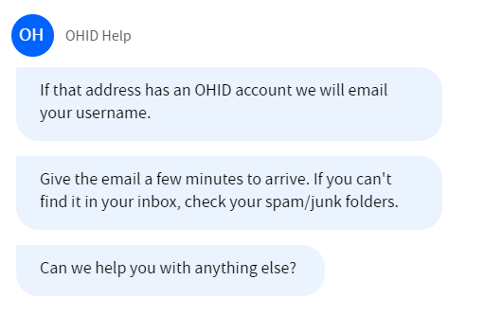
OHID Username Recovery
3. The user will enter their “email address” and will click “Submit.”
3
4. The user will receive an email containing their username. Once received they can log into their OHID account.
4

Slide 11
OHID Password Recovery

Slide 12
OHID Password Recovery
1. If customers with an existing OHID need support with their username or password, they should open the OHID account recovery chatbot by selecting “Forgot your OHID or password” under the “Log In” button.
1
2. After selecting “Forgot your OHID or password” a chatbot will open to help support customers with username recovery or password reset. The user should select “I forgot my password.”
2

Slide 13
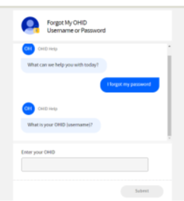
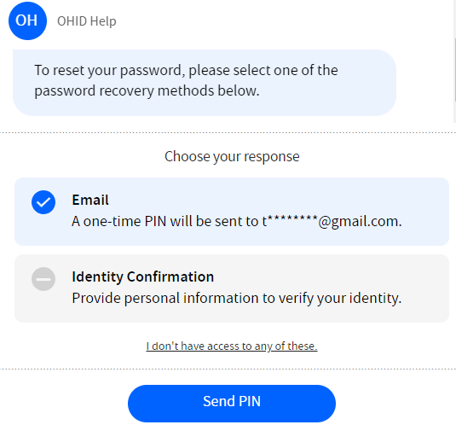
OHID Password Recovery
3. The user will enter their “OHID (username)”and will click “Submit.”
3
4. The user will follow their password recovery methods to reset their password.
4

Slide 14
OHID FAQs

Slide 15

OHID General FAQs
These are common questions Adoption Grant users may have about OHID
1
Question: I can’t login to my OHID. How do I access my account now?​
Answer: If you are not able to access your account, you should follow the “Reset account/ Password” protocol to access your OHID account. If you need further assistance, please go to OHID Self-Service Resources. Recovering an existing account is preferred, but not always feasible due to the possibility of a disabled account.
2
Question: I already have an OHID account, why can’t I access it anymore?​
Answer: The most common reasons for not being able to access your OHID is the possibility of duplicate accounts or forgetting your password. To troubleshoot, you can use “Forgot User ID” and/or “Forgot Password” to gain account access. If that does not work or for further assistance, please visit OHID Self-Service Resources. ​
3
Question: I already created my OHID but haven't received any confirmation email. How do I get access to my account?​
Answer: Troubleshooting help will be available on the email verification screen. You can add the DONOTREPLY-EnterpriseIdentity@Ohio.Gov​ email address to your contact list or ask IT administrators to add this email to the safe-sender list. ​

Slide 16
OHID Account Creation FAQs
These are common questions Adoption Grant users may have while creating their OHID Account
1
Question: I went to create an OHID but it said my email is already associated with an account. What do I do?
Answer: There is a possibility you created an account in the past. To troubleshoot, you can use “Forgot User ID” and/or “Forgot Password” to gain account access. If that does not work or for further assistance, please visit OHID Self-Service Resources. ​
2
Question: I entered my email and have not yet received a PIN. What do I do?​
Answer: It may take a few minutes for the PIN to come through via email. If you have not received it after a few minutes, check your spam or junk folder. Additional troubleshooting help will be available on the email verification screen. You can add the DONOTREPLY-EnterpriseIdentity@Ohio.Gov email address to your contact list or ask IT administrators to add this email to the safe-sender list.

Slide 17
OHID Account Creation FAQs
These are common questions Adoption Grant users may have while creating their OHID Account
3
Question: ​If I already have an OHID account for another agency, can I use that to access Adoption Grant?
Answer: Yes! If you have an OHID account that you already use for another agency, then your existing OHID account can also be used to access Adoption Grant services.
4
Question: ​My team currently shares credentials. Will we be able to share an OHID account?
Answer: No. OHIDs are for individual use only. For security purposes, do not share your OHID with anyone. This will help keep sensitive information secure and prevent access by bad actors or unauthorized users.
5
Question: What if I get an error message when creating my account?
Answer: Error messages may be a result of OHID security enhancements. Customers should try the following resolution techniques:
Check that personal information was entered correctly
Change to another device, or use the internet browser on their cell phone
Log in within their normal geographic location

Slide 18


Advisory: OHID Account Creation Issue
Last year, the Department of Administrative Services (DAS) InnovateOhio Platform (IOP) deployed enhancements to the State’s Identity Proofing technology to proactively defend Ohioans and the State from cyberattacks, fraudulent activity and bad actors. As a result, some Adoption Grant customers may experience error messages when creating a new OHID account.
What do I communicate to customers?
Advise customers that this is due to the OHID account creation/account update process as the result of proactive security enhancements by the State of Ohio.
What actions can customers take to resolve this issue?
Customers can take the following actions to work around the issue:
Check that personal information was entered correctly
Change to another device, or use the internet browser on their cell phone
Log in within their normal geographic location
How do I escalate more challenging technical issues?
If the above troubleshooting techniques do not work, and the customer is still receiving an error message, the DCY helpdesk should escalate issues to the CSC on behalf of the customer.

Slide 19
OHID Allow List

Slide 20
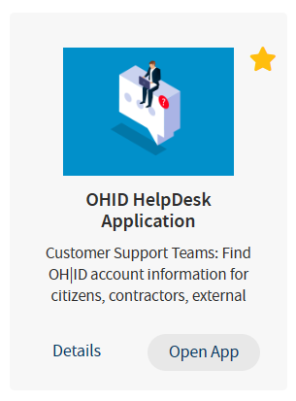
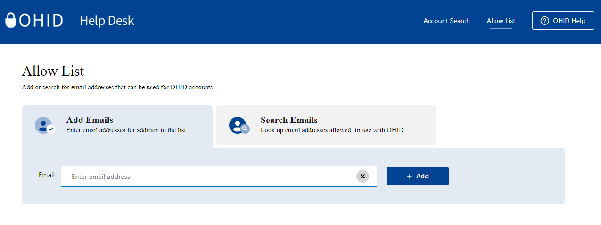
OHID Allow List Training
Agencies wanted a self-service option to reduce customer delay to add emails to the Allow List
Allow List added to the OHID Help Desk app as a new tab (top right)
Allow List is a troubleshooting option.
– Doesn’t guarantee successful OHID account creation
1
2

Slide 21
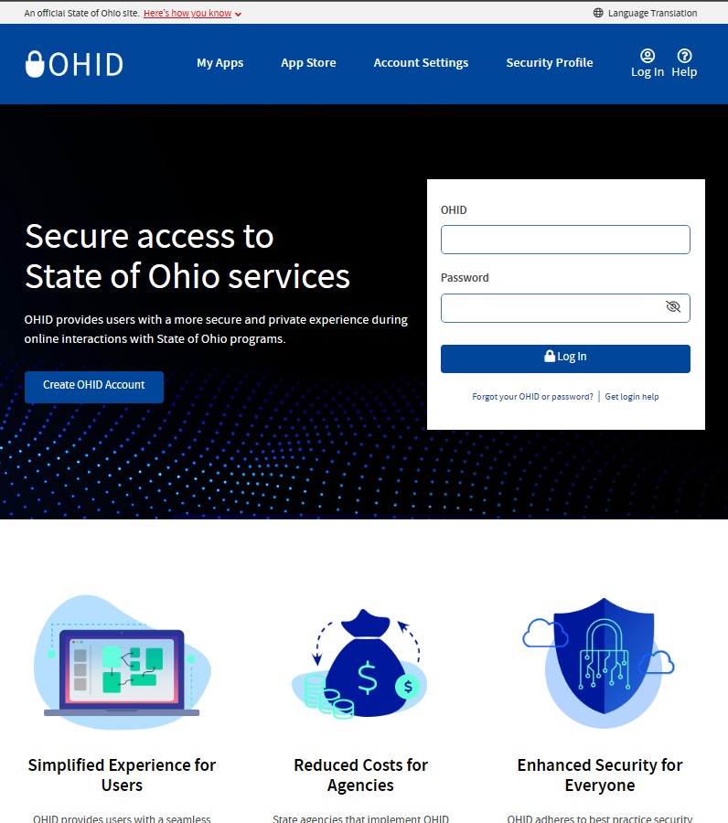
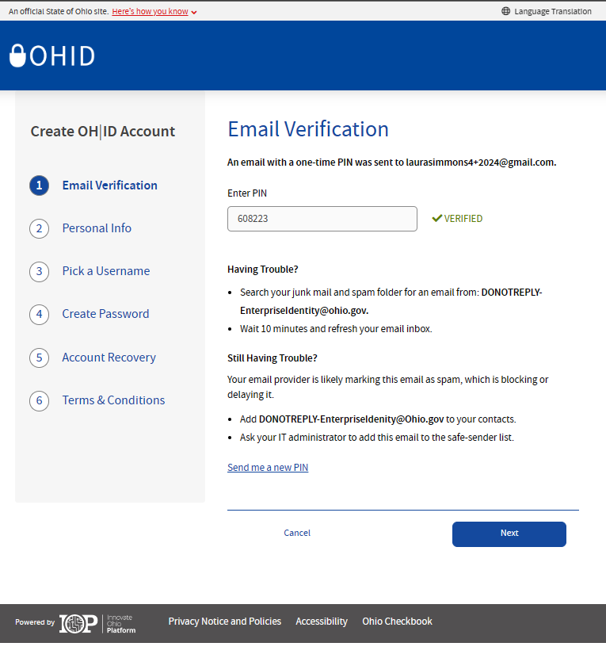
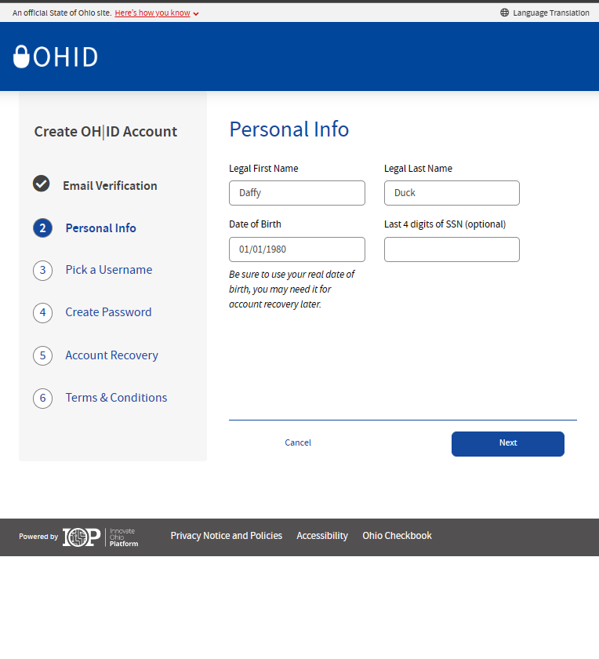
Error from a customer POV: This is where you may see yourself wanting to try to aid the customer by using the Allow List
When to Use the Allow List
Create OHID Account Flow: Create Account | OHID | Ohio's State Digital Identity Standard
1
2

Slide 22
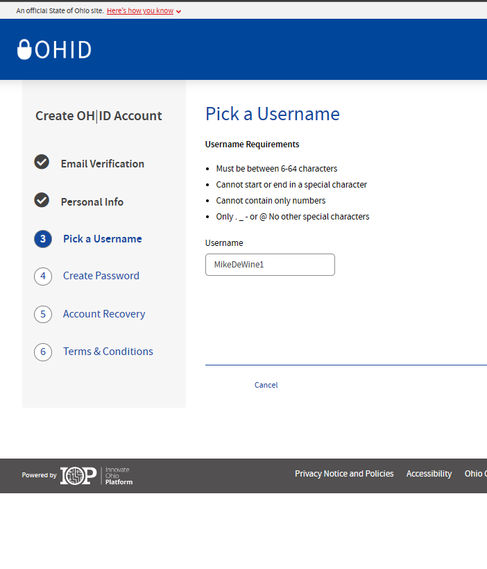
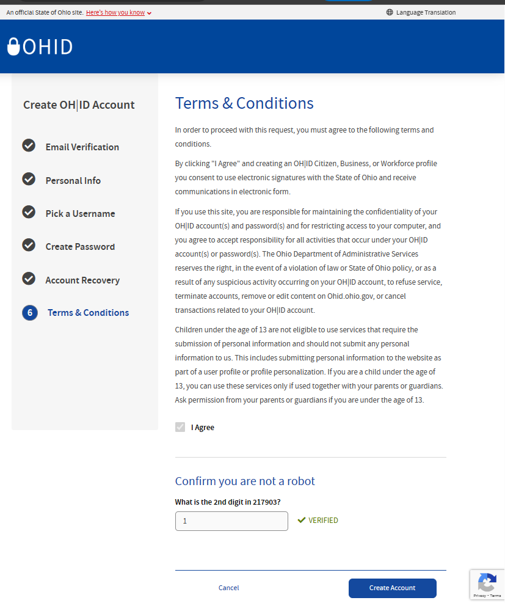
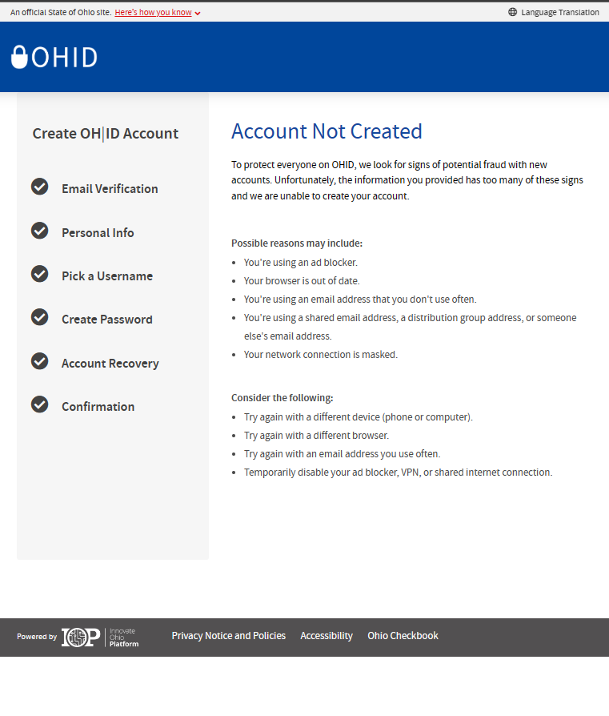
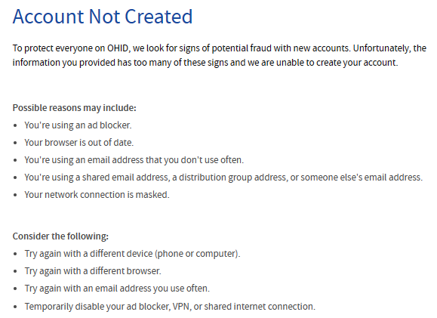
When to Use the Allow List
3
4
5

Slide 23
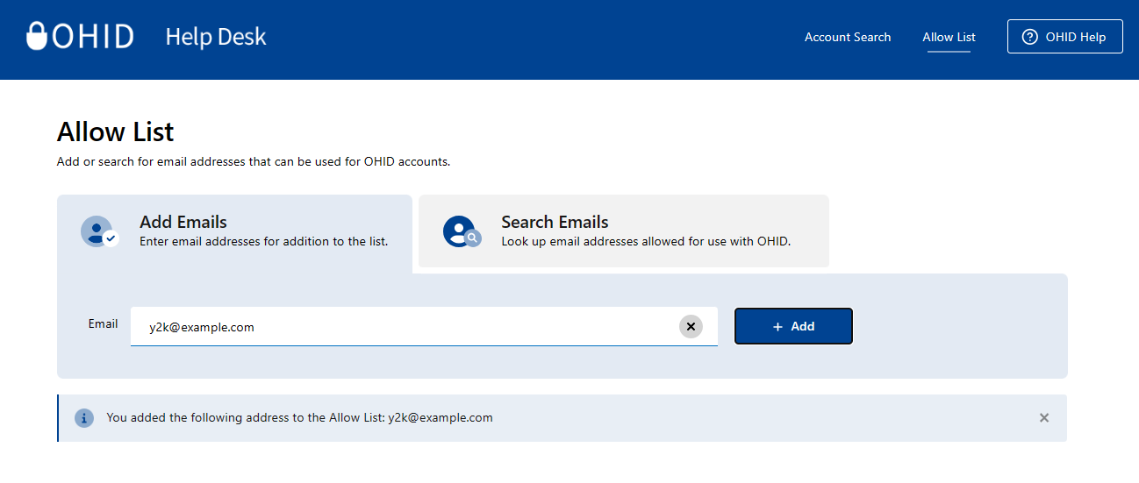
The OHID Help Desk App: Allow List
Add email addresses to the Allow List to enable users with rejected emails to create an OHID account
1
If someone is getting an error or they wish to have more than one email associated with their account, in the help desk dashboard on the left-hand side, applicable help desk agents can add email addresses for OHID users
They can type in the email address they wish to add to the allow list for the user, then select “Add’
Once successfully added, they should see the following confirmation: “You added the following address to the Allow List: [Email]”
2
3
Notes:
Have them try another different device (laptop, desktop, smart phone, tablet)
Search before adding
Once added, they can try again immediately
1
2
3

Slide 24
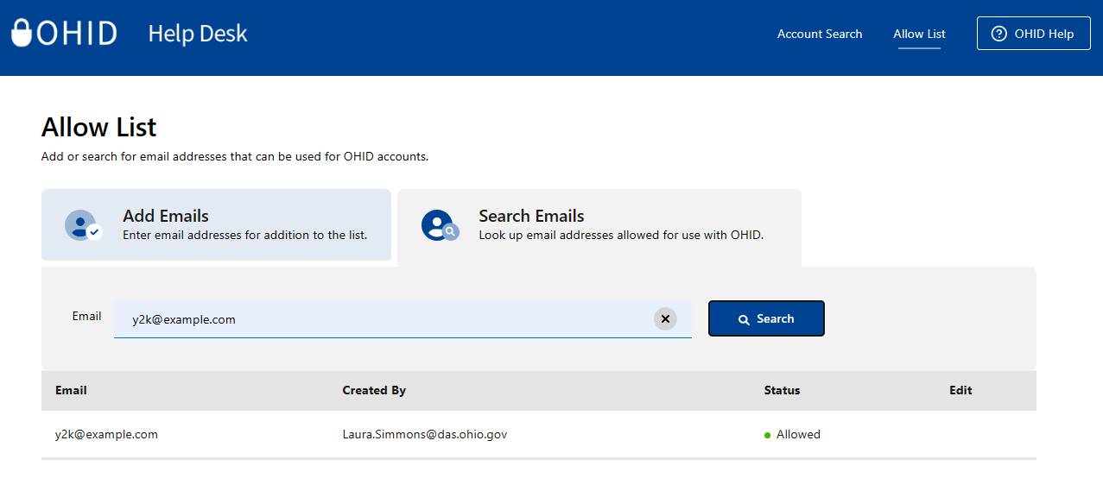
The OHID Help Desk App: Search Functionality
Help Desk Agents can use the Search functionality to help troubleshoot issues with previously allowed email addresses
1
If someone is getting an error, in the help desk dashboard on the right-hand side, applicable help desk agents can search emails under Search for Allowed Emails. Type in the users email address and select “Search”
Type in the users email address and select “Search”
Their email address will pop up, alongside who the email was created by and their status, for appropriate agents to verify
2
3
1
2
3

Slide 25
Multi-Factor Authentication
(MFA)

Slide 26
What are OHID and MFA?
OHID
MFA
A citizen's log-in credentials to access their State of Ohio Account(s)
Second form of identity verification during the login process
Unique identifier for single sign-on access into a variety of state agency websites and portals
Helps keep sensitive information more secure
MFA policy to provide additional security authentication
Familiar to those using online banking applications, or other sensitive online accounts
OHID SSO refers to a sign on process that enables secure access to multiple state agency resources, including OAGP applications, through a single set of unique log in credentials (OHID and Password).
MFA is a second form of verification that confirms the user logging in is who they claim to be. There will be multiple options available, including SMS text message, email, phone call, Fido authentication, IBM Verify App, and Authenticator Apps.
OHID and MFA work together to help keep confidential and sensitive information secure.

Slide 27






MFA Registration Options Overview
There are six options available for MFA Registration. All users must register for at least two required MFA options. It is recommended to choose a combination of phone-based and email options.
SMS Text Message
Fido Device
An SMS text with a PIN will be sent to the user’s phone number.
User is given the option to register an authenticator to enable passwordless authentication.
Email
Authenticator App
A PIN will be sent to the user’s email address.
User is given the option to verify with a one-time access code that is generated by an authenticator app on a mobile phone or tablet.
Phone Call
IBM Verify App
An automated call will be made to the user’s phone number.
User is given the option to authenticate through PIN displayed in app and an in-app push button option.
Indicates Recommended

Slide 28

MFA Registration Options Overview
SMS Text Message
Email
An SMS text with a PIN will be sent to the user’s phone number.
A PIN will be sent to the user’s email.
Low
Low
The SMS verification option sends the user a one-time access code to their phone via text message.
Users must select an active mobile phone number.
For text message and phone call verification to be counted as separate methods, users cannot use the same phone number for both options.
The Email verification option sends the user an email containing a one-time verification code to the email address they used to setup MFA.
Users should use an active email account they have access to.
Levels of Difficulty
28

Slide 29

MFA Registration Options Overview
Phone Call
IBM Verify App
An automated call will be made to the user’s phone number.
User is given the option to authenticate through PIN displayed in app and an in app push button option
Low
Medium
The IBM Verify verification app will send a push notification when selected as the MFA option.
The IBM Verify app is free in both the Google Play and Apple App stores.
The Phone Call verification option places an automated phone call to the user’s phone number.
Users must select an active phone number.
For text message and phone call verification to be counted as separate methods, users cannot use the same phone number for both options.
Levels of Difficulty
29

Slide 30

30
MFA Registration Options Overview
Fido Device
Authenticator App
User is given the option to register an authenticator to enable passwordless authentication.
User is given the option to verify with a one-time access code that is generated by an authenticator app on your mobile phone or tablet.
High
Medium
The Authenticator App will send a time-based one-time password when selected as the MFA option.
The Authenticator App is free in both the Google Play and Apple App stores.
User has to buy a FIDO device in order to utilize this verification method.
User is required to touch the physical token for each verification attempt.
Levels of Difficulty

Slide 31
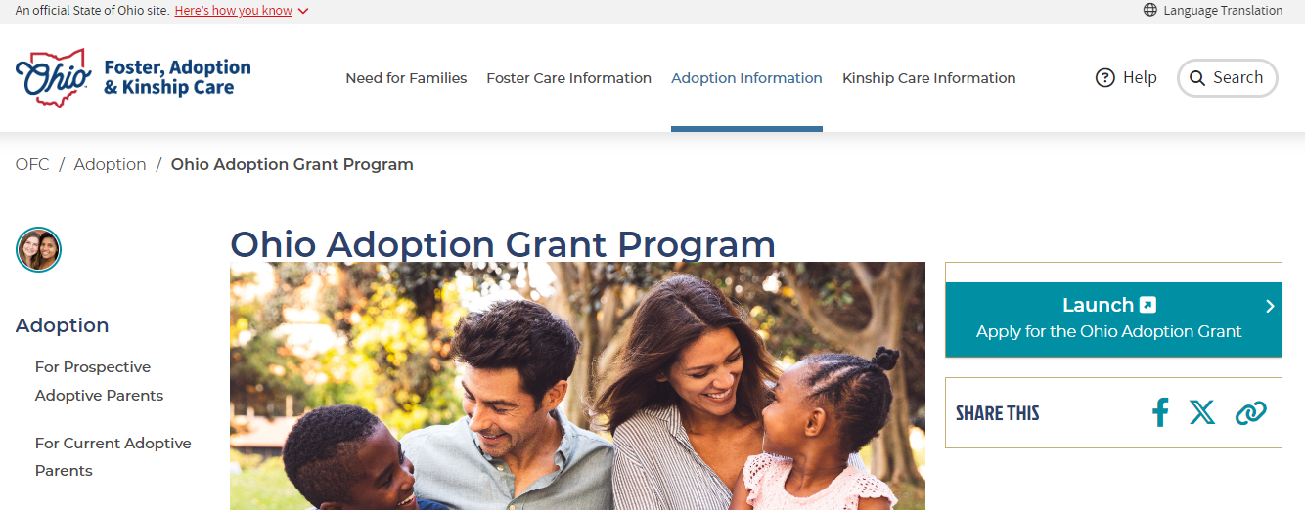
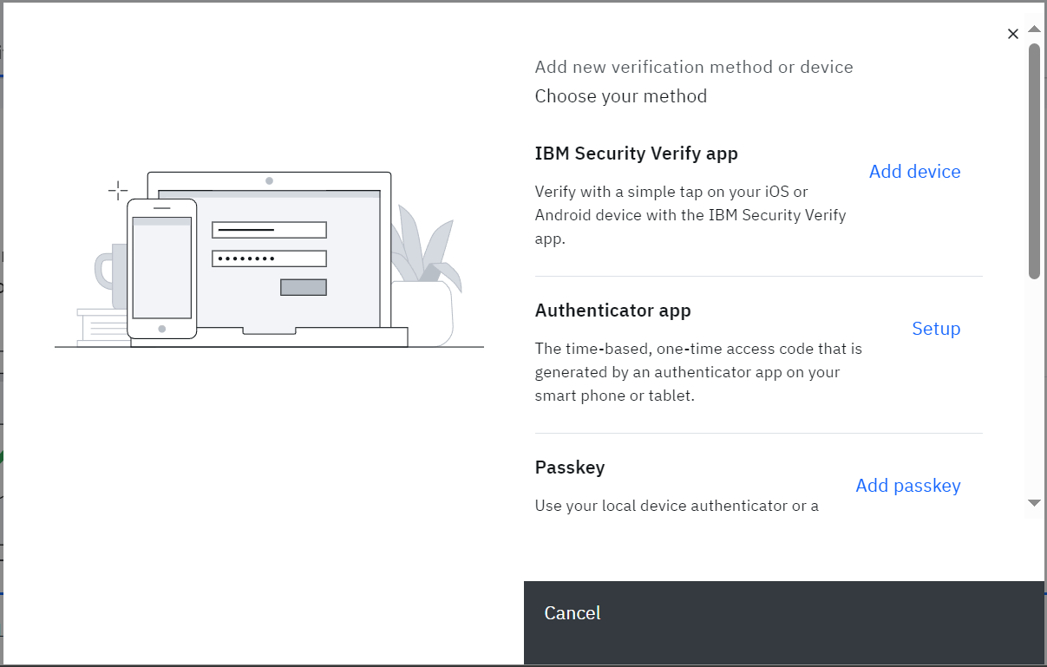
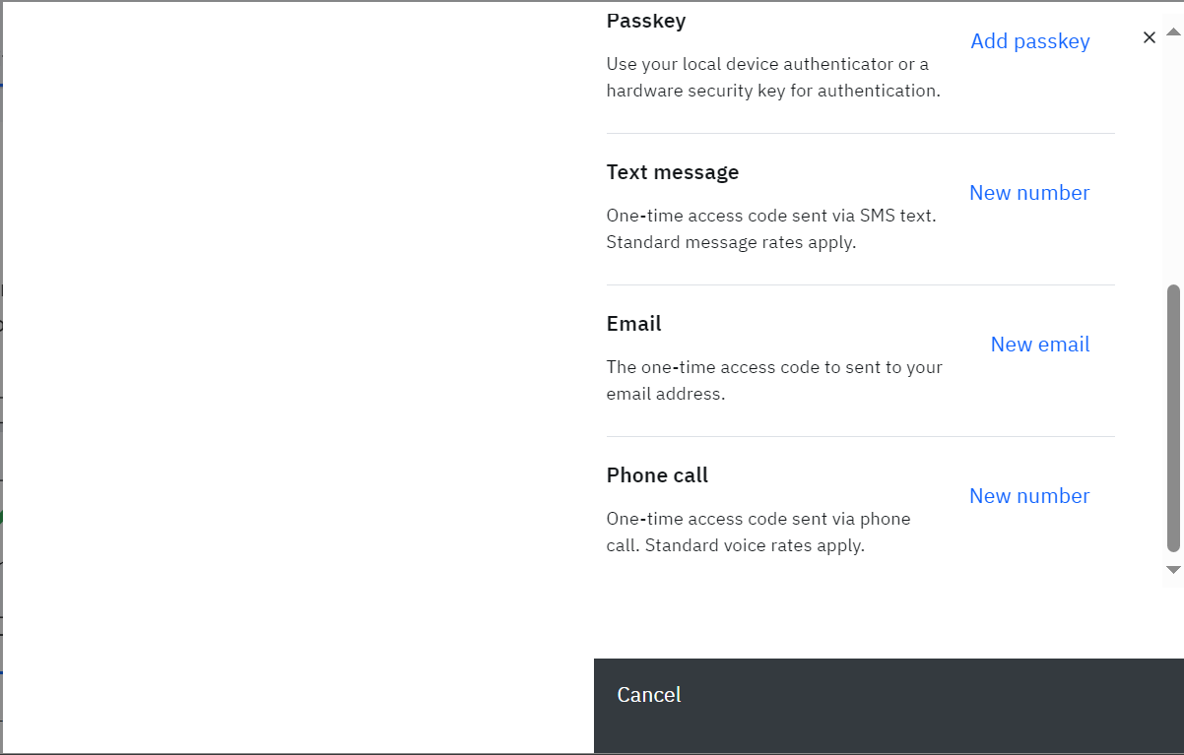
MFA Enrollment
1. The user will navigate to the Adoption Grant Application Website
Users can navigate to the Adoption Grant Application Website at the following URL: Ohio Adoption Grant Program | Foster Care and Adoption in Ohio
Users should select “Launch” to Apply for the Ohio Adoption Grant
1
2
2. The user will visit OHID.ohio.gov and log in using their OHID and password.
Note: Users can only enroll in 2-Step Verification options on the OHID website
3. The user will see all verification methods appear on the screen for selection.
Note: Users will need to set up 2 methods of verification. It is recommended that they select one phone-based option (Phone call or text) and one email option.
3

Slide 32
TEXT MESSAGE
Multifactor Authentication Enrollment Method

Slide 33
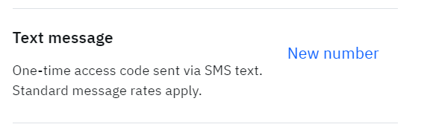
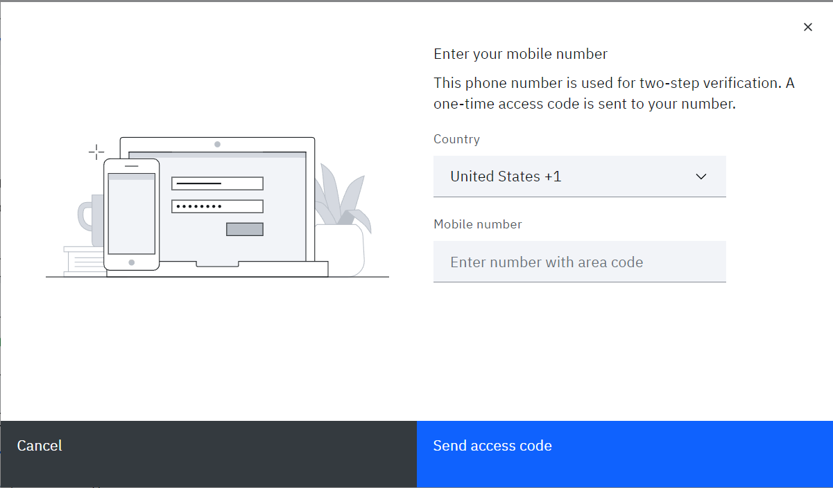
MFA - Text Message
1. The user will select “New number” highlighted in blue.
1
2
2. The user will enter their Mobile number and select “Send access code”.
Note: If the same phone number is entered for more than one 2-Step Verification option, they will be prompted to "Enroll another method”

Slide 34
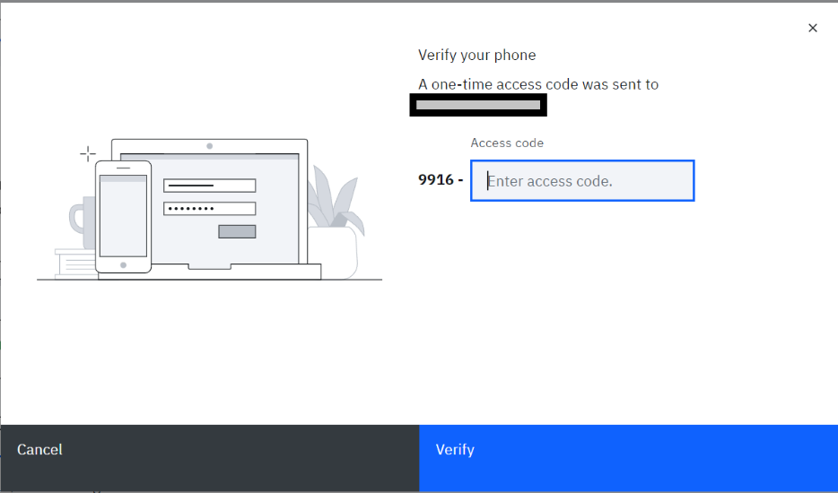
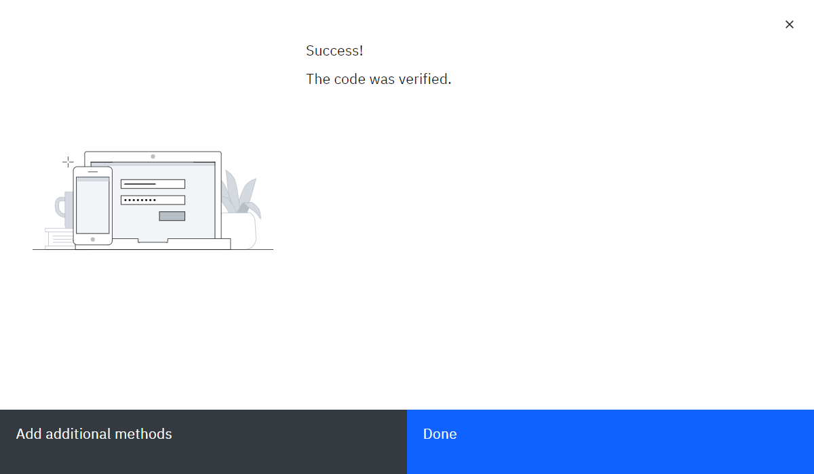
MFA - Text Message
3
3. User will enter the access code that appears in the text message sent to them and select “Verify.”
4. Once the user enters and verifies their access code, they will see this page showing that they have successfully added the text message method of verification. They may select “Add additional method” if they have not yet enrolled in two methods or select “Done” if they have already done so.
4

Slide 35
EMAIL
Multifactor Authentication Enrollment Method

Slide 36
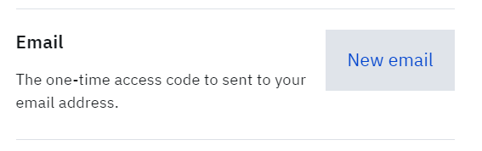
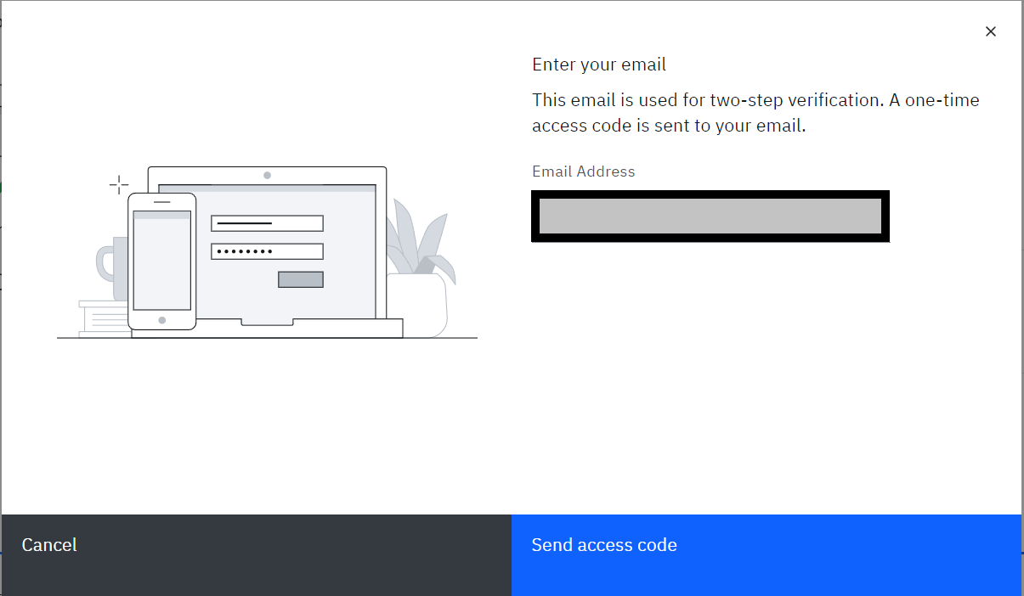
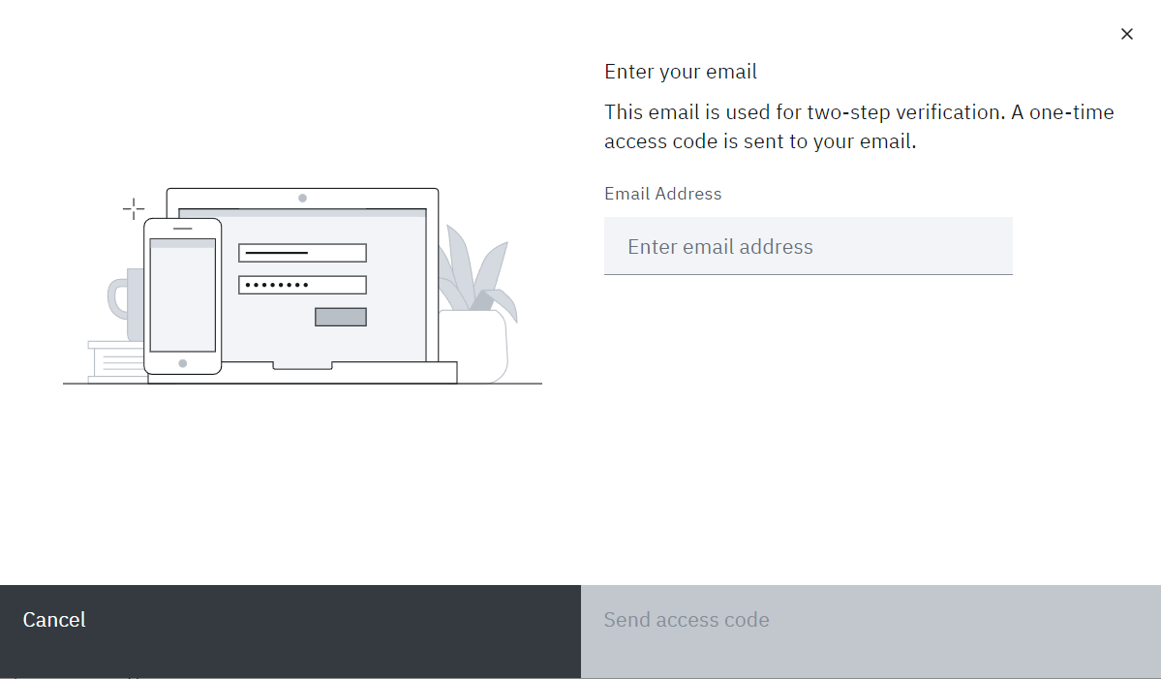
MFA - Email
1
1. The user will select “New email” highlighted in blue.
2
2. The user will enter their email address and select “Send access code”

Slide 37
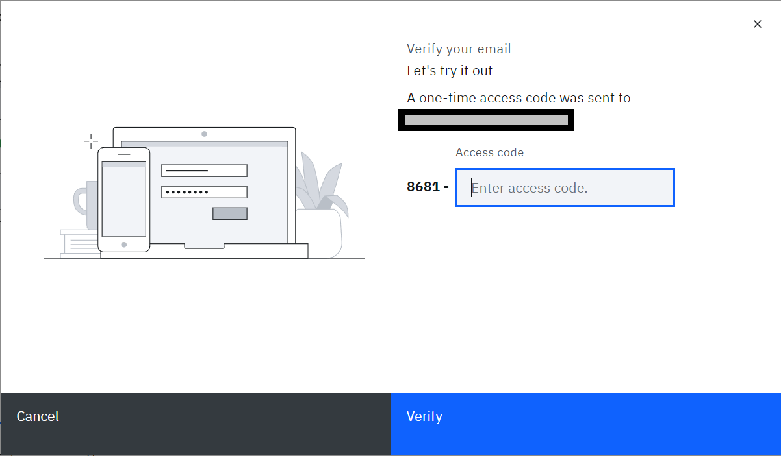
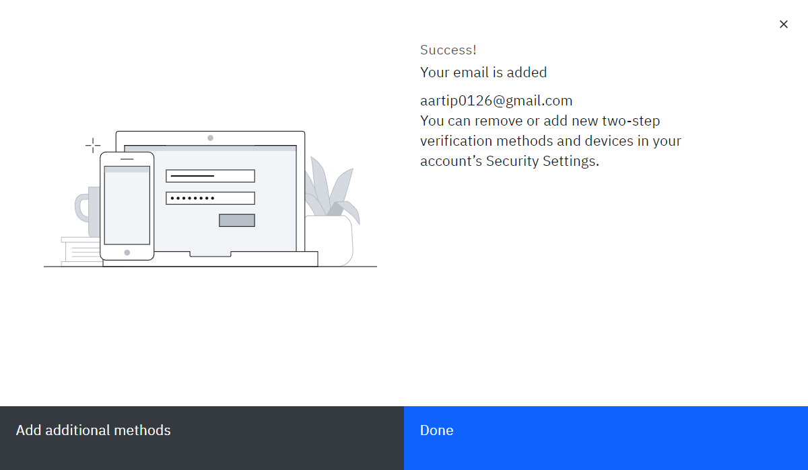
MFA - Email
3
3. User will enter the access code that appears in the email that was sent to them and select “Verify.”
Test@Gmail.com
4
4. Once the user enters and verifies their access code, they will see this page showing that they have successfully added the email method of verification. They may select “Add additional method” if they have not yet enrolled in two methods or select “Done” if they have already done so.
Test@Gmail.com

Slide 38
PHONE CALL
Multifactor Authentication Enrollment Method

Slide 39
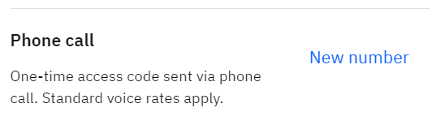
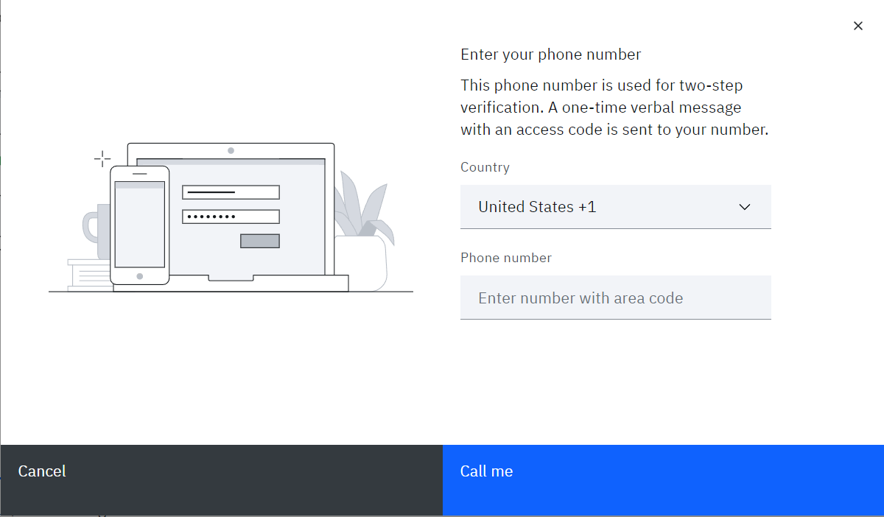
MFA - Phone Call
1
1. The user will select “New number” highlighted in blue.
2
2. The user will enter their phone number and select “Call me”.
Note: If the same phone number is entered for more than one 2-Step Verification option, they will be prompted to "Enroll another method”

Slide 40
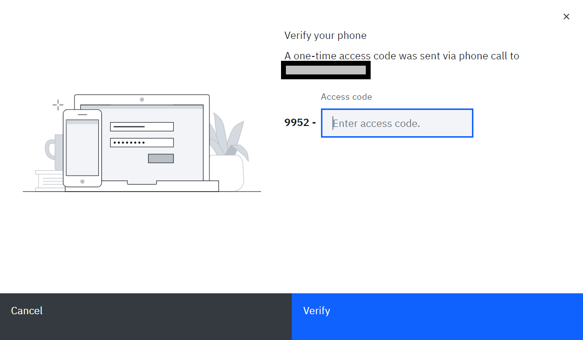
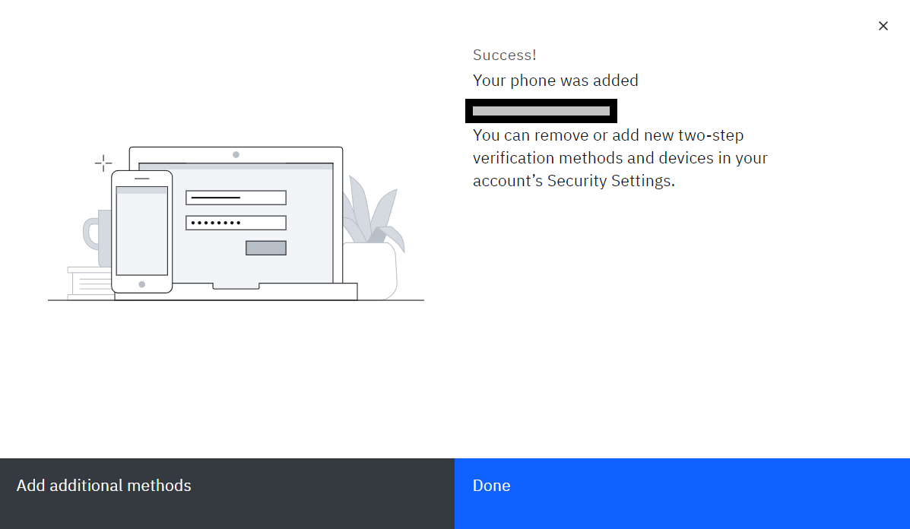
MFA - Phone Call
3
3. User will pick up the phone call they receive and enter the access code that the automated messenger reads to them and select “Verify.”
1-000-000-0000
4. Once the user enters and verifies their access code, they will see this page showing that they have successfully added the phone call method of verification. They may select “Add additional method” if they have not yet enrolled in two methods or select “Done” if they have already done so.
4
1-000-000-0000

Slide 41
IBM Verify
Multifactor Authentication Enrollment Method

Slide 42
Multifactor Authentication Enrollment: IBM VERIFY BEST PRACTICES
Before enrolling in the IBM Verify option, please download the IBM Verify application from the Apple App Store or the Google Play store.
The QR code provided to link your MFA option to your device/application is for one-time use only. If you fail to connect the application the first time, you will need to return to the initial MFA enrollment page, select add device, select “IBM Verify” and begin the process again.
The option for biometric login is dependent on your device capability.
  E.g., If you have an iPhone with a “home” button (iPhone 8/8s) with TouchID activated, you can use the biometric confirmation. Any models without a “home” button and TouchID will be unable to confirm identity with biometrics. However, if you have FaceID enabled, you can select that option for biometric confirmation.
Although IBM Verify is not a “phone-based option” like SMS Text and Phone Call, we still recommend choosing an email-based backup as your secondary MFA option. If you do not have access to your registered phone number(s), you will not be able to complete MFA with IBM Verify, SMS Text or Phone Call, but will be able to complete MFA via email.

Slide 43
MFA - IBM Verify
1
1. After selecting “Add Device” on the initial MFA enrollment page, the user will download the IBM Verify App to their device and press “Connect Your Account”.
2. After pressing “Connect your account” the user will be met with the following screen and will need to scan the QR code to continue the registration.
2
3. The user will scan the QR Code using the IBM app by opening the App’s Camera.
3

Slide 44
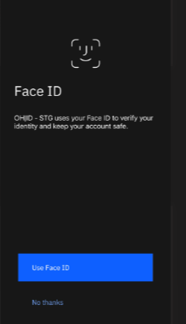
MFA - IBM Verify
4. Choose Biometrics or FaceID (based on your phone settings.) This has no bearing on linking the account to MFA so you can click “Not now/No thanks.” if you do not want to utilize this feature
4a
4b
5. Approve the connection after scanning the QR code (only for biometrics.)
6. Your account is now linked, press “Done”
6
5

Slide 45
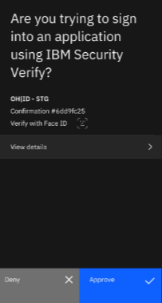
MFA - IBM Verify
7. User will select “Verify your device” to continue with IBM Verify Enrollment.
8. The user will receive an “authentication challenge” to the IBM Verify app. To complete this, they will open the app, click the challenge, and approve the connection.
Note: The IBM Verify App does not allow screen shots for this step.
7
9
8
9. The user will select “Approve” when the push notification is received.
10. After successfully completing the authentication challenge, the user will be met with the following screen. From here they can select “Add Additional Methods” if they need another MFA option or “Done” if they are finished enrolling. Pressing “Done” will redirect them to the Application.
10

Slide 46
Authenticator App
Multifactor Authentication Enrollment Method

Slide 47
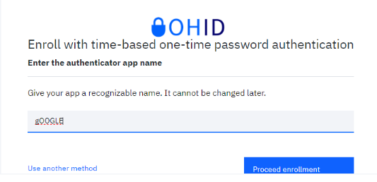
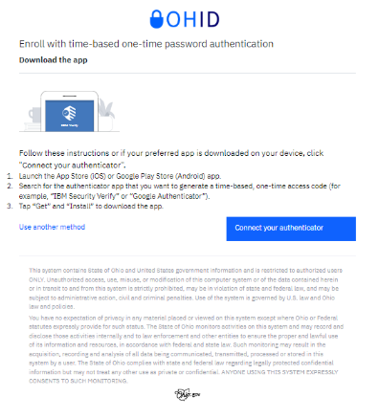
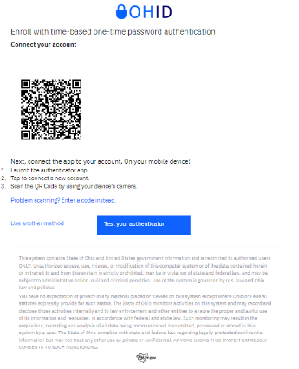
MFA - Authenticator App
1. After selecting “Set up” on the initial MFA enrollment page, the user will name their “authenticator app” and will select “Proceed enrollment.”
1
2. The user will then download the authenticator app, follow the instructions and then select “Connect your authenticator.”
2
3. The user will then scan the QR code to connect the account and will select “Test your authenticator.”
3

Slide 48
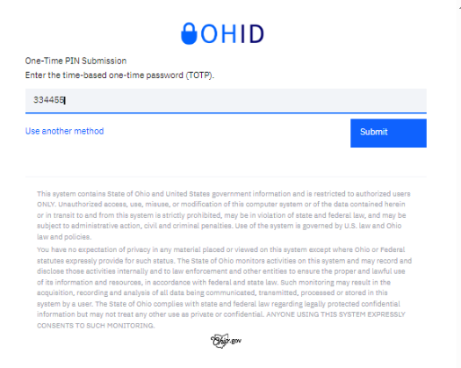
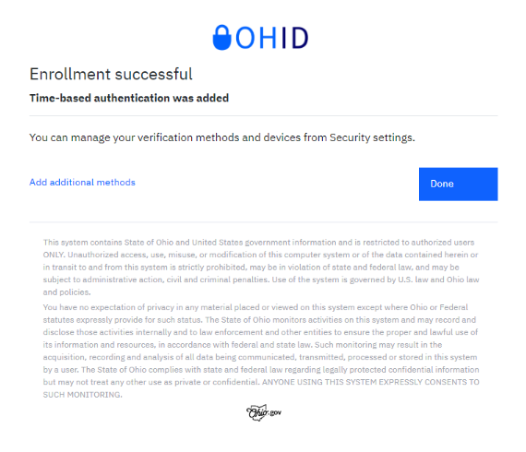
MFA - Authenticator App
4. The user will enter the time-based one-time password that prompts on the authenticator app on their mobile device, and they will select “Submit.”
4
5. Once the security PIN is verified, Authenticator App enrollment will be successfully added. The user will then select “Add additional methods” if they need to set up a second MFA option or they will select “Done” if both MFA options have been set up.
5

Slide 49
Fido Device
Multifactor Authentication Enrollment Method

Slide 50
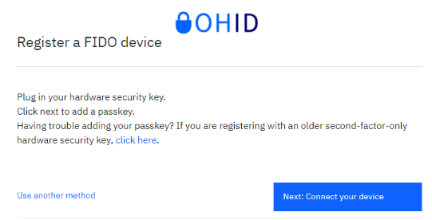
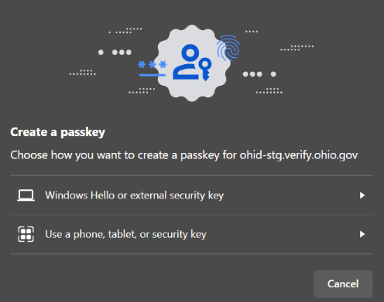
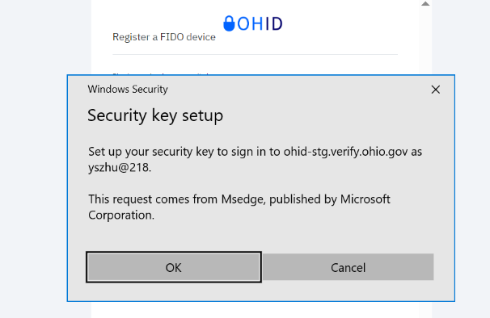
MFA – Fido Device
1. After selecting “Add device” on the initial MFA enrollment page, the user will select “Next: Connect your device”.
*Fido requires the purchase of a physical token to successfully enroll this method.*
1
2. If a user creates a token through their laptop, then they should select the “Windows Hello or external security key” option. If a user creates a token through their cell phone, then they should select the “using a phone, tablet, or security key” option.
2
3. User will be prompted to set up their security key. The user will select “OK.”
3

Slide 51



MFA – Fido Device
4
4. User will be prompted to continue to setup their security key. User will select “OK.”
5. User will need to create and then confirm the security key PIN and select “OK.”
5
6. User needs to touch the security key with their finger.
6

Slide 52


MFA – Fido Device
7. User will need to name their FIDO device and then select “Done.”
7
8. Once the security PIN is verified, FIDO device enrollment will be successfully added. The user will then select “Add additional methods” if they need to set up a second MFA option or they will select “Done” if both MFA options have been set up.
8

Slide 53
MFA FAQs

Slide 54
MFA FAQS
These are common questions Adoption Grant users may have about MFA
1
Question: My Multifactor Authentication (MFA) failed. Why did this happen?
Answer: Your MFA can fail for various reasons such as putting an incorrect or expired PIN, waiting too long to approve a push notification, or accidently selecting decline on the push notification. If the MFA method you have chosen failed, please try your preferred option again, or use a secondary method.
2
Question: Do I need any additional apps to log into the Adoption Grant Application Website?
Answer: You can use the IBM Verify App, a different authentication app, or Fido Device to complete MFA. However, you will still have the option for SMS, Phone Call, and Email to complete MFA, so you do not need any additional applications.
3
Question: I have added text and phone call as my MFA options, why does the system tell me I still need a second method?
Answer: For text message and phone call to count as separate forms of MFA, you must use a different phone number for each method. If you do not have two numbers, you will need to enroll in either Email or IBM Verify as your secondary MFA option.

Slide 55
MFA FAQS
These are common questions Adoption Grant users may have about MFA
4
Question: I am using Email for MFA and have not received a code, what do I do?
Answer: Check your spam folder if you are not receiving the passcode directly to your inbox. If this does not work, attempt to use a secondary MFA option.
5
Question: ​If I use the automated telephone option, what number shows on the caller ID, and what steps do I complete to authenticate successfully?
Answer: The number may look different for each user, but users can add the number to their contacts. Customers will receive a phone call and will be provided a PIN over the phone. After answering the call, customers will enter the PIN provided by the automated voice to authenticate and log in successfully. If the call is not answered, a voicemail will be left with the verification code. The code will remain valid for 5 minutes after the call.
6
Question: I have an iPhone, and when I receive a telephone call from an unknown number, it does a silent ring, and if I select answer, the iPhone rings the number back; if customers do this, what would be the result.
Answer: ​If you miss the call or the call is silenced, the automated phone call will leave a voicemail with the PIN. Please be mindful of the time limit for confirmation and complete your MFA authentication as quickly as possible.

Slide 56
MFA FAQS
These are common questions Adoption Grant users may have about MFA
7
Question: If a customer sets up more than 2 MFA options, how can they verify during this process?
Answer: The system will only trigger the option that they select to use when verifying, but all their set up enrollment options will be available to them to choose from.
8
Question: Will the phone verification options work with a Google phone number?
Answer: As long as the number can receive SMS messages or phone calls, there’s nothing to prevent it from being used for MFA.
9
Question: Can a single phone number be used by more than one person? For example, a citizen who may not own their own phone (e.g. shelters where multiple people may share a phone).
Answer: There’s nothing to prevent that. However, if a text or phone call is sent to that phone, and the user doesn’t have it in their possession, they will not be able to access the application. Furthermore, the loss of that method will render multiple accounts unusable.

Slide 57
MFA FAQS
These are common questions Adoption Grant users may have about MFA
10
Question: If the customer is not able to use their verification code after five minutes, is there a limit on the number of times they can request a verification code before they are locked out?
Answer: There is not currently a limit on the number of times a customer requests a verification code when setting up MFA methods.
11
Question: Why am I receiving this error “404 Page not found”?
Answer: The “404 Page not found” error typically means the user doesn’t have proper access or there may be an issue with caching. This could also be a result of the occurrence of data mismatch between the agency and IOP.
12
Question: Why am I not receiving a phone call on my phone when trying to enroll in the Phone Call MFA option?
Answer: Phone carriers have scam blocking apps that may interfere with the delivery of MFA calls. Any sort of SPAM/RoboCall blocking software should be disabled when troubleshooting this issue. You may also check your carrier's application settings for additional options to adjust allowed calls.

Slide 58
ID Proofing

Slide 59



Identity Proofing Process
1. Once MFA Setup is complete, user will begin Identity Proofing process.​
User will be prompted to Identity Proof and will select “Begin Identity Confirmation”
1
2. User will fill out required Identity information. ​
The user will fill out the Personal, Residential and Mobile Phone Verification (Optional). The user will then select “Submit”​
2
3. User will verify their information.​
​
User will be prompted to verify their information and then will click “Submit”. ​
​
*Please note that if a User does not enter a “Mobile Number” then it will make it less likely that their identity will be confirmed.*​
3

Slide 60



Identity Proofing Process
4a. User passes ID Proofing​
​
User passes ID Proofing and will select “Continue” to be rerouted to complete DocV.
4a
4b. User fails ID Proofing
​
User fails ID Proofing and will select continue to be rerouted to complete DocV.
4b
4c
4c. User is ‘referred’ to ID Proofing
​
User scores refer in ID Proofing and will select continue to be rerouted to complete DocV.
5. User will move forward to complete DocV after completing ID Proofing
User is transitioned to DocV to continue the verification process.
5

Slide 61
Document Verification
(DocV)

Slide 62
DocV Process: Overview
The Socure Document Verification (DocV) module has 3 main components citizens will go through when completing: Referral, Identification Upload, and Taking a Selfie
Referral
After a user completes Identity Proofing, they will be referred to complete DocV. The OHID landing page will display a pop-up informing users that their identity will need to be verified once more and present them with the opportunity to continue to the DocV application
Identification Upload
Once a user continues to DocV, they will be prompted to upload the front and back of an accepted form of identification. This must be a real-time photo of the ID
Take a Selfie
Once a users accepted form of identification has been uploaded, they will be prompted to take a live image of themselves. DocV will then biometrically verify their identity
Users will need the following to complete DocV:
State-issued driver’s license, ID, or passport
Access to a smartphone or tablet with a camera
Chrome browser for an Android device
Safari browser for an iOS device

Slide 63

DocV Process: Referral [Desktop View]
Once users complete the Identity Proofing process, users will be prompted to complete DocV.
1
1. User will be prompted to complete DocV and will select “Begin document verification.”
2. User will fill out the prompted information and select “Continue”
2

Slide 64



DocV Process: Referral [Desktop View]
Once users complete the Identity Proofing process, users will be prompted to complete DocV.
3
0
3. The user will confirm that their information is correct. Once confirmed, the user will select “Yes, continue”
4
4. The user will send themselves a link via SMS text or scan the QR code via mobile device & will be taken to DocV
5
5. The user will select “Get started” and proceed with the directions to access the DocV application. Users will need a mobile phone or a tablet with a camera

Slide 65




DocV Process: Referral [Mobile View]
Once users complete the Identity Proofing process, users will be prompted to complete DocV.
1
2
1. A screen will pop up informing that their identity has not finished being confirmed. Users should select “Continue.”
2. Users can read about DocV and select “Continue to Document Verification” and then “Complete Document Verification.”
3
4
3. Users should fill out the prompted information and hit “Continue.” Once the information is confirmed, they should select “Yes, submit.”
4. Users should select “Get Started” and proceed with the directions to access the DocV application.

Slide 66






DocV Process: Identification Upload
Once a user has accessed DocV, they can begin their verification process by uploading a government issued ID.
1
1. Users should select “Start Verification” and accept the Terms and Consent.
2. Users should select which type of supported ID they want to use and allow DocV access to their camera
Accepted Forms of Identification
State Drivers License
State ID Card
Passport
Military IDs are not accepted
2
3. Users should follow the instructions for taking a picture of the front and back of their selected ID
3

Slide 67




DocV Process: Identification Upload
After uploading the front and back of their selected ID, users will be prompted to take a picture of themselves to complete the DocV verification process.
4. Users should move the phone or tablet in front of their face and follow instructions for taking a picture of themselves.
4
5
5. Once their selfie is captured, users should ensure their full face is visible in the image and submit their selfie.
6
7
6. Users will wait a few seconds for DocV to process
7. Once DocV has shown successful, users should close the application and navigate back to the original application landing page.

Slide 68
DocV: Best Practices
      1. High Resolution Camera
  Users should use a high-resolution camera to capture fine details with clarity
      2. Proper Lighting Conditions for Identification Documents
  Users should put their document up against a white wall or in front of a blank piece of paper
  Users should take their image in daylight to maximize the contrast between the object and the background
      3. Proper Lighting Conditions for a Selfie
  Users should take their selfie in daylight to maximize contrast between themselves and their background
  Users should hold the phone steady to avoid a blurry image
  Users should ensure their face is clearly visible and wear a neutral expression during their selfie

Slide 69
ID Proofing/DocV FAQs

Slide 70
ID Proofing/ DocV FAQs
These are common questions Adoption Grant users may have about the ID Proofing/ DocV processes
1
Question: Where is my data going?
Answer: OHID & Socure have detailed privacy statements. For interested parties, please refer to the OHID Privacy Statement and Socure’s Privacy Statement to learn more about the collection and use of personal information.
2
Question: What if my facial features are no longer similar to my features in my ID?
Answer: DocV does not take gender into account, so transitioning will not change the outcome unless major cosmetic surgery is performed. If this is the case, the law states you should update your ID.
As far as face tattoos, burns, or scars - These should not be an issue as DocV uses a vector of over 100 numbers that represent the most important features of the face in the image. DocV predicts the likelihood that the two facial images belong to the same person by comparing the distance between the facial embeddings.
3
Question: Why am I not passing ID Proofing?
Answer: ID Proofing is a process based on identifying potentially suspicious account indicators. Sometimes this information provided does not match sourced information. During ID Proofing, there are 3 areas that can be triggered as a result: Pass, Absolute Fail, and Refer. Please double check they are entering their personal information correctly and confirm the following:
Are they logging in from a new device? Are they logging in from a new location? Have they created a new email address or phone number?

Slide 71


ID Proofing/ DocV FAQs
These are common questions Adoption Grant users may have about the ID Proofing/ DocV processes
4
Question: What if I see this during the DocV process?
“An error has occurred. Try again”
Answer: There may have been a backend processing error. Close the DocV application and try the process again. If you keep getting issues, please reach out to Socure for additional assistance.
5
Question: What if I see this during the DocV process? “This link works on mobile devices and on supported browsers. Please use Chrome browser on Android and Safari on iOS”
Answer: If you are using an Android Device, please ensure you are using a Chrome browser. If you are using an iOS Device, please ensure you are using a Safari browser.

Slide 72


ID Proofing/ DocV FAQs
These are common questions Adoption Grant users may have about the ID Proofing/ DocV processes
6
Question: What if I see this during the DocV process?
“You have reached the maximum number of resubmit attempts”
Answer: You are only able to attempt DocV 2 times within a 72-hour time period. Please try the DocV process from the beginning after the 72-hour time period has passed.
7
Question: What if I see this during the DocV process? ”Your session has expired”
Answer: You may have been in the middle of the session and stepped away for a minute. DocV times out after 60 minutes. Please go back to the original browser to begin the DocV process again.

Slide 73


ID Proofing/ DocV FAQs
These are common questions Adoption Grant users may have about the ID Proofing/ DocV processes
8
Question: What if I see this screen during the DocV process?
“You hit a problem. Our team is working on it”
Answer: There may have been a backend processing error. Close the DocV application and try the process again. If you keep getting issues, please reach out to Socure for additional assistance.
9
Question: What if I see this screen during the DocV process?
“Current browser cannot analyze the video stream. Please use Chrome browser on Android or Safari on iOS”
Answer: The browser you are using is not supported. If you are using an Android Device, please ensure you are using a Chrome browser. If you are using an iOS Device, please ensure you are using a Safari browser.

Slide 74

ID Proofing/ DocV FAQs
These are common questions Adoption Grant users may have about the ID Proofing/ DocV processes
10
Question: What if I see this screen during the DocV process?
“Communication with server failed. Please check your network connection”
Answer: Your internet connection may be weak. Troubleshoot and ensure you are connected to Wi-Fi. If you are able to use data, try taking yourself off your Wi-Fi connection if you are not able to get a stronger signal.
11
Question: How are ID Proofing scores determined?
Answer: During the ID Proofing process, impact indicators are triggered to evaluate the user's identity. Based on these indicators, one of three ID Proofing scores is assigned: pass, fail, or refer. For purposes of access to the Adoption Grant application, refer and fail will be treated the same.
12
Question: Can expired licenses or other forms of outdated identification be used for authentication with DocV?
Answer: No, Socure requires valid, non-expired identification to complete DocV successfully.

Slide 75
ID Proofing/ DocV FAQs
These are common questions Adoption Grant users may have about the ID Proofing/ DocV processes
10
Question: Does DocV accept any passports that are not US Passports?
Answer: Yes, Socure's identity verification system can process non-U.S. passports to confirm a user's identity.
11
Question: Are there any phone model and operating system requirements for DocV?
Answer: To function properly, Socure DocV requires a minimum iOS version of 13 and later or Android OS version of Android 5.1 (SDK Version 22) and later.

Slide 76



Incident Management Reminders
DCY Customer Contact Center Agents should escalate technical issues that cannot be resolved with self-service materials to the CSC on behalf of customers. Do not provide the CSC email to customers, it is for internal agency use only. To make sure tickets are documented correctly please review the process flow and reminders below:
1
2
3
Utilize provided troubleshooting steps on the previous slide before proceeding to Step 2
Create a CSC ticket via email with documentation described below
(CSC@Ohio.Gov)
Share the ticket link with Matt Lein @ matthew.lein@das.ohio.gov and Aarti Patel @ aarti.patel@das.ohio.gov
TICKET INFO
IDENTIFIERS
DETAILS
Please include:
in your email subject line when submitting tickets via email. This will help us get tickets to the correct group for resolution.
Please capture the below personal information from users experiencing issues:
Email address
Name
Agency
Phone Number (Optional)
If they receive an error message, please ask them to provide the following when possible:
Screenshot of the error message
URL or page
Browser used (Edge. Google Chrome)
“Adoption Grant” or “Adoption Grant – MFA” or “Adoption Grant – ID Proofing/DocV”

Slide 77

Points of Contact
For OHID support or troubleshooting insight please review OHID Help
For unresolvable technical issues or support, submit a ticket to CSC@ohio.gov describing your issue
Please find a list of all local JFS office locations for an in-person review here: Local Agencies Directory | Job and Family Services
For any additional questions, please contact us at OFC-Ohioadoptiongrant@childrenandyouth.ohio.gov

